Slide 1

Smash Burger Mafra
Hardik Patel

Slide 2
INSTRUCTIONS
How to use this template?
Click on "File" and then "Make a Copy" of the template to use it.
Edit each of the slides and table to add your responses.
Come up with a catchy title for the project and do not simply write "Minor Project 3: Search Engine Optimisation Strategy for FlinkIt".
Use the primary colours and logo of the assigned brands on the Cover Page and wherever necessary in the project.
Feel free to use your creativity to make the most use of the given template.
The maximum Number of Slides that can be used is 20.
Once you are happy with your responses, click on "Share", download it into a PDF file and submit it on the MyCaptain WebApp.

Slide 3
PROBLEM STATEMENT
Hello This is Our First and New Burger Shop. And we make website and promote.

Slide 4
OBJECTIVES
Edit this slide to add the objectives of the Project

Slide 5
APPROACH
Edit this slide to add the Project approach statement

Slide 6
TASK 1 - CREATE A WEBSITE STRUCTURE
Website structure is the different types of pages you will have on your website and how are they connected with each other. You can create a Hierarchical, or tree-like structure for your website, something that is user-friendly and easily navigable.
You can edit this slide to add your Website Structure or paste a screenshot.

Slide 7
Smash Burger Mafra
Home
Menu
About
Contact
Food
Drinks
Burger
Combo
Extra
Beer
Cocktail

Slide 8
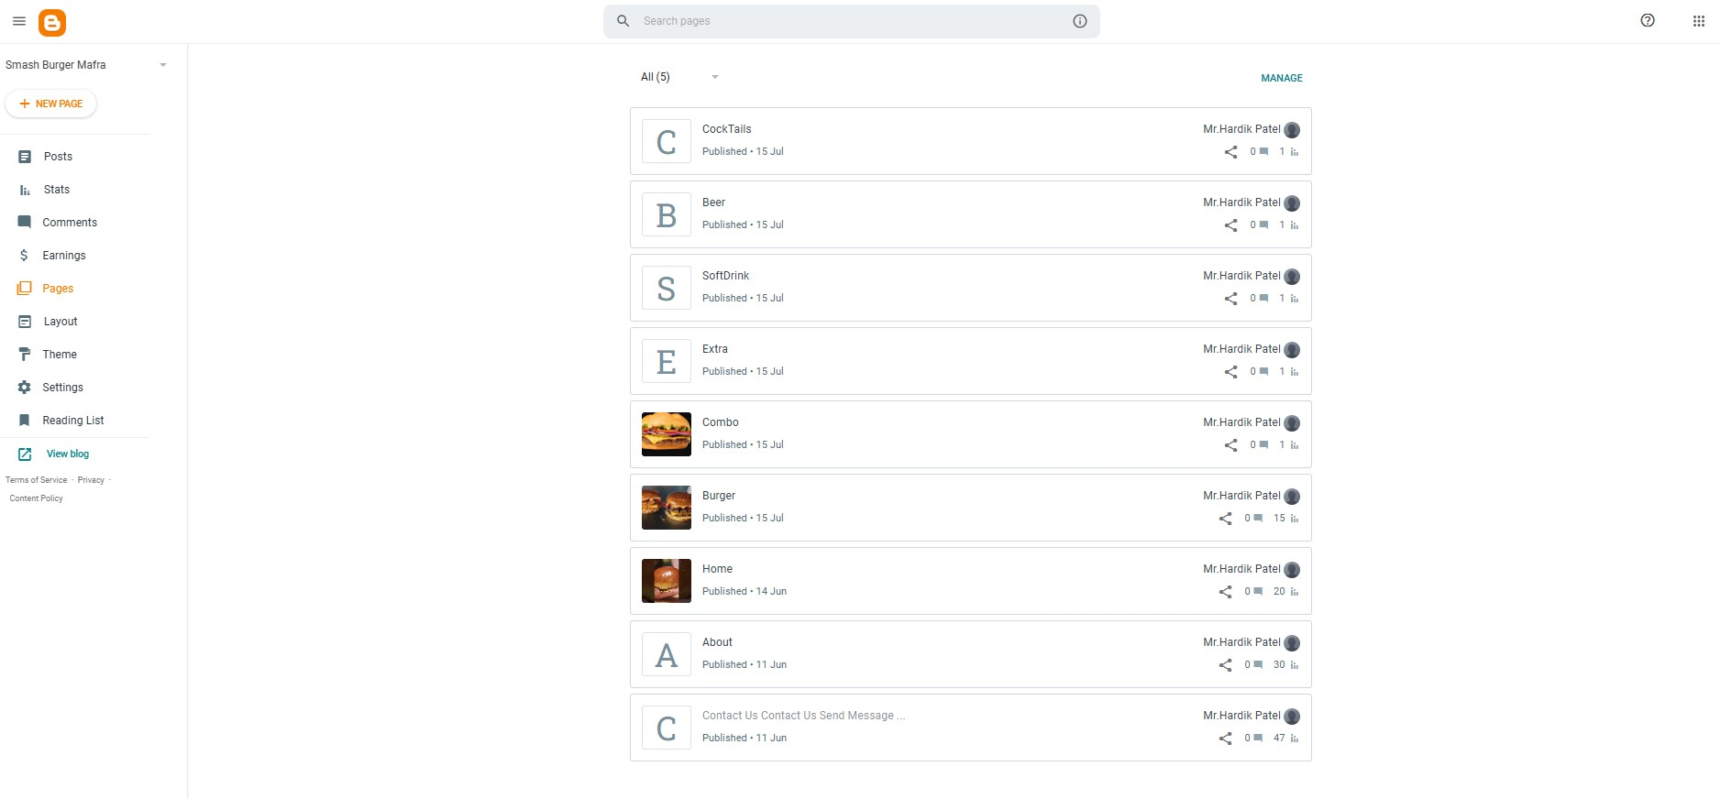
All Page List

Slide 9
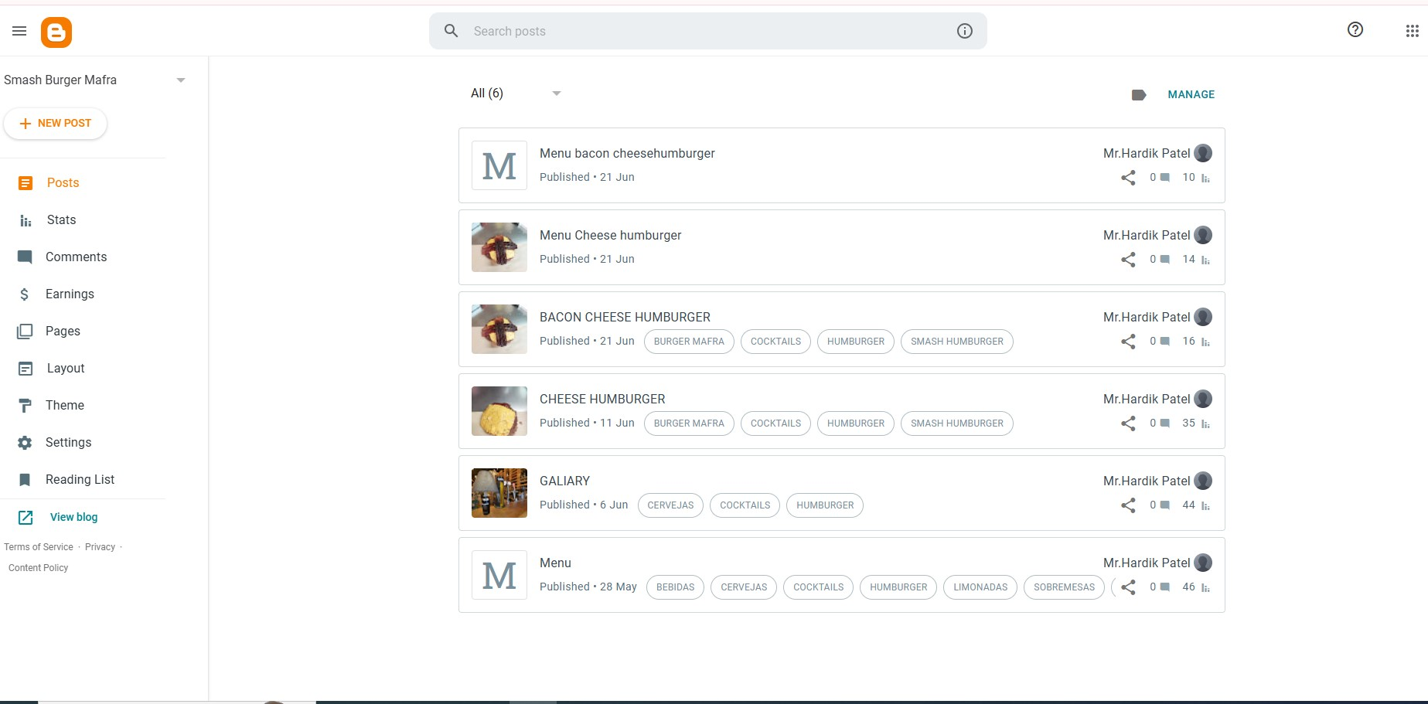
All Post

Slide 10
TASK 2 - TOPIC IDEAS
List out all the different blogs your website should contain and all the different products your website should cover. Come up with as many topic ideas as possible but work on just 3 of them for the next steps - 1 Blog, 1 Product page, and 1 product category page.

Slide 11
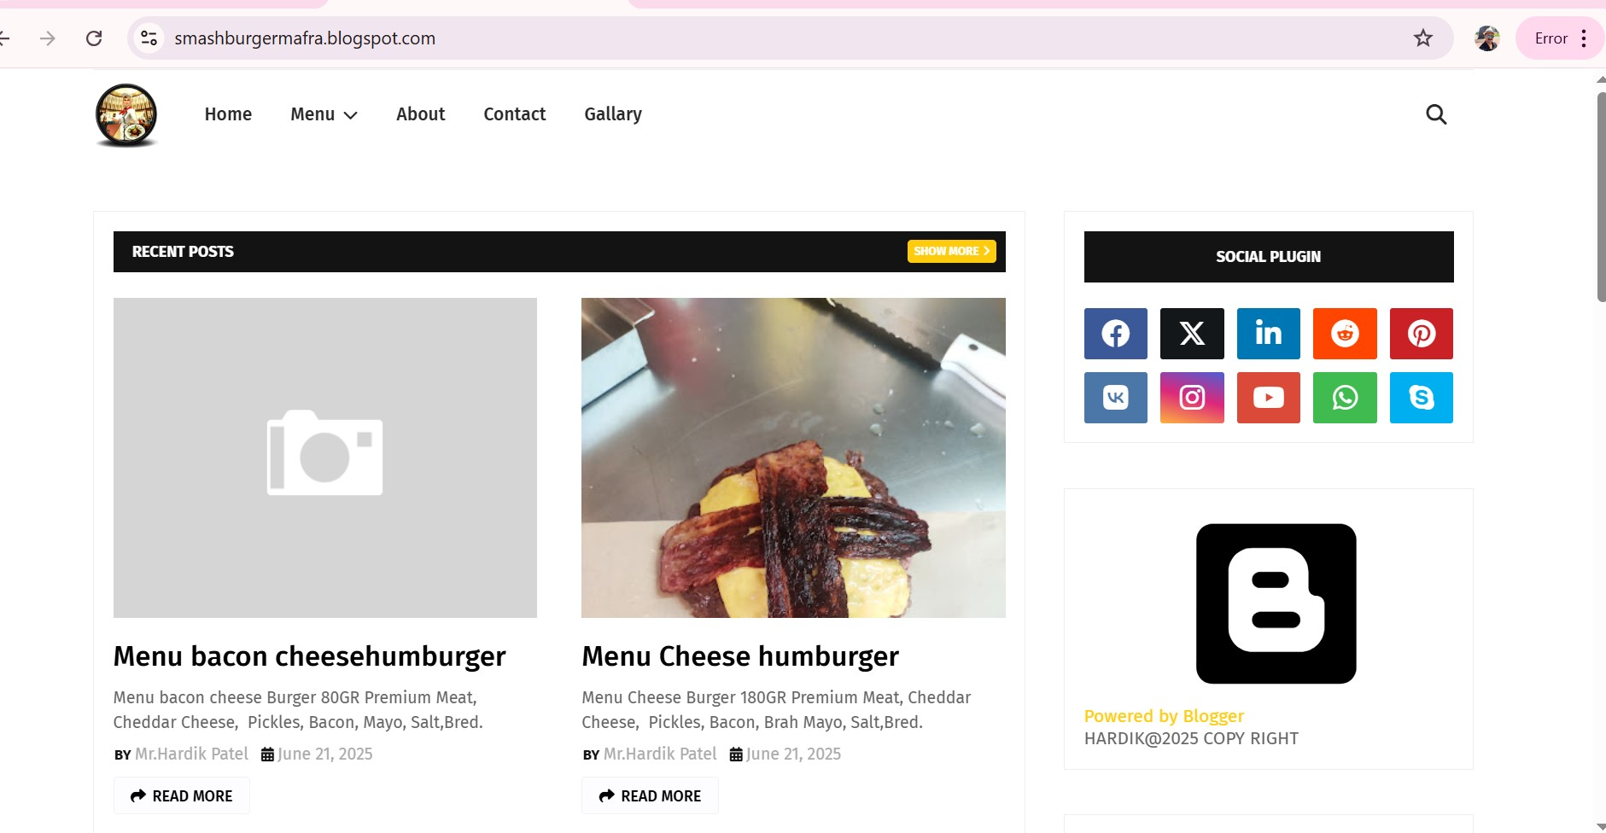
Blog Page

Slide 12
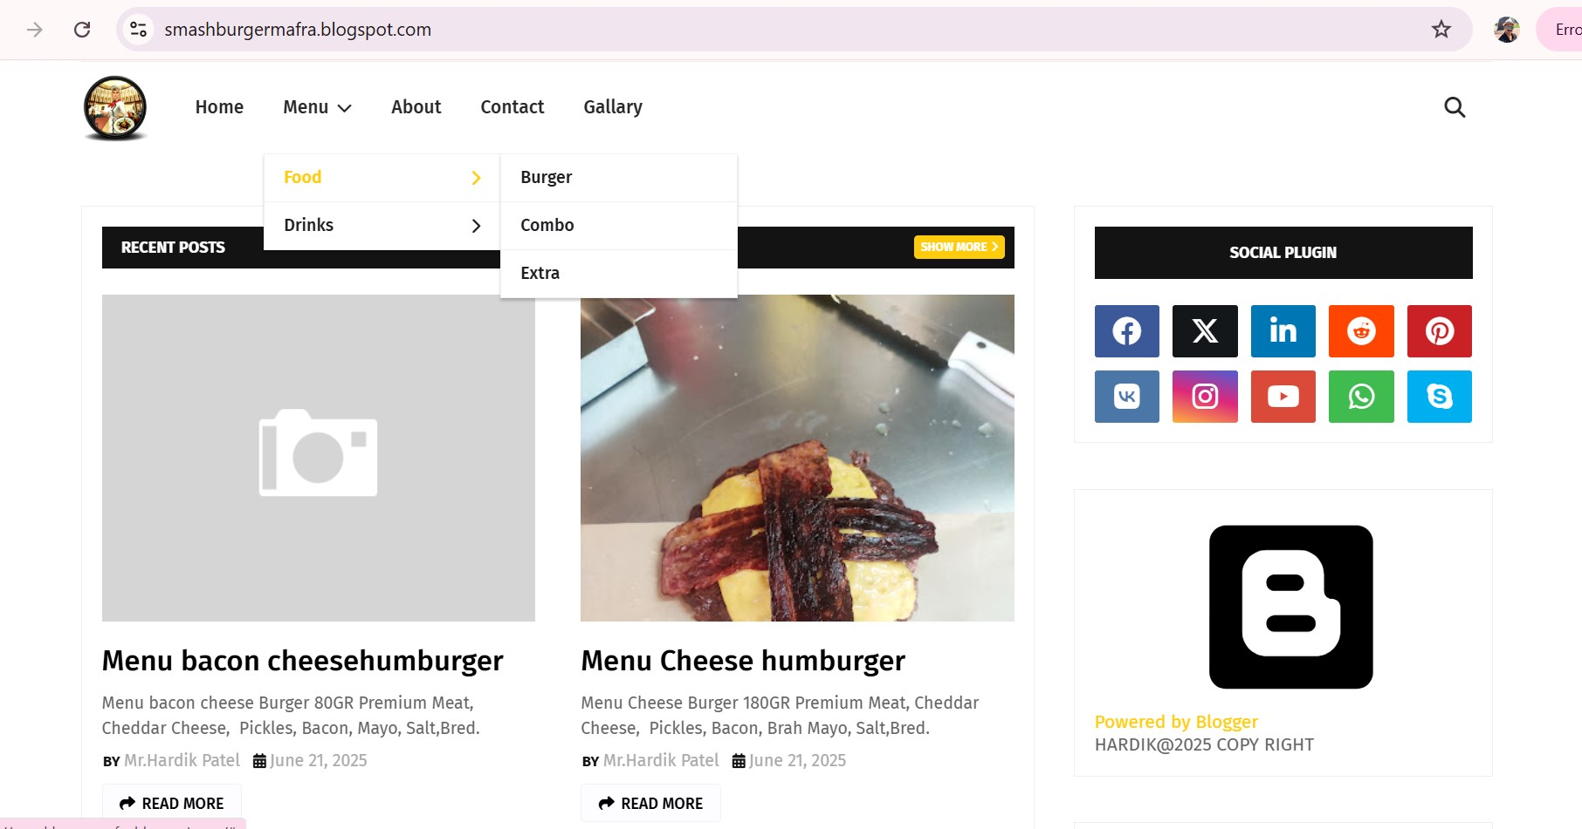
Menu Page
https://smashburgermafra.blogspot.com/p/burger.html

Slide 13
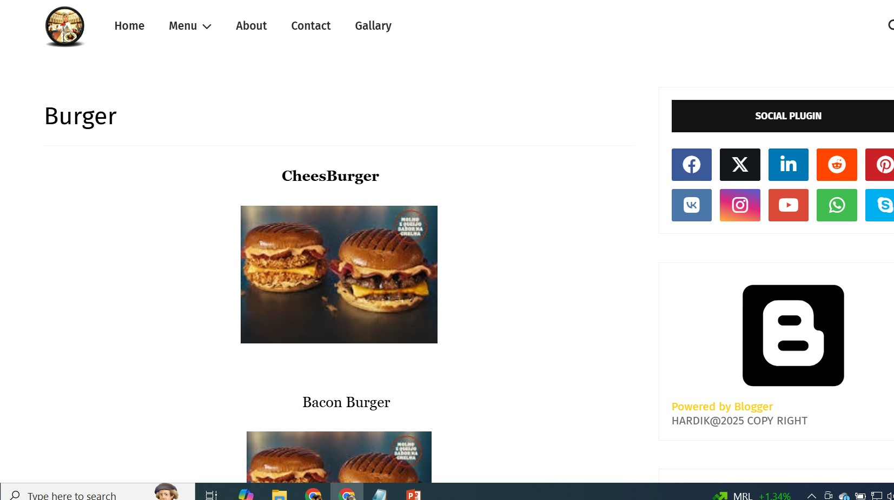
Product Catagery Page
Here Is 2 Product 1. CheeseBurger And Bacon Burger

Slide 14
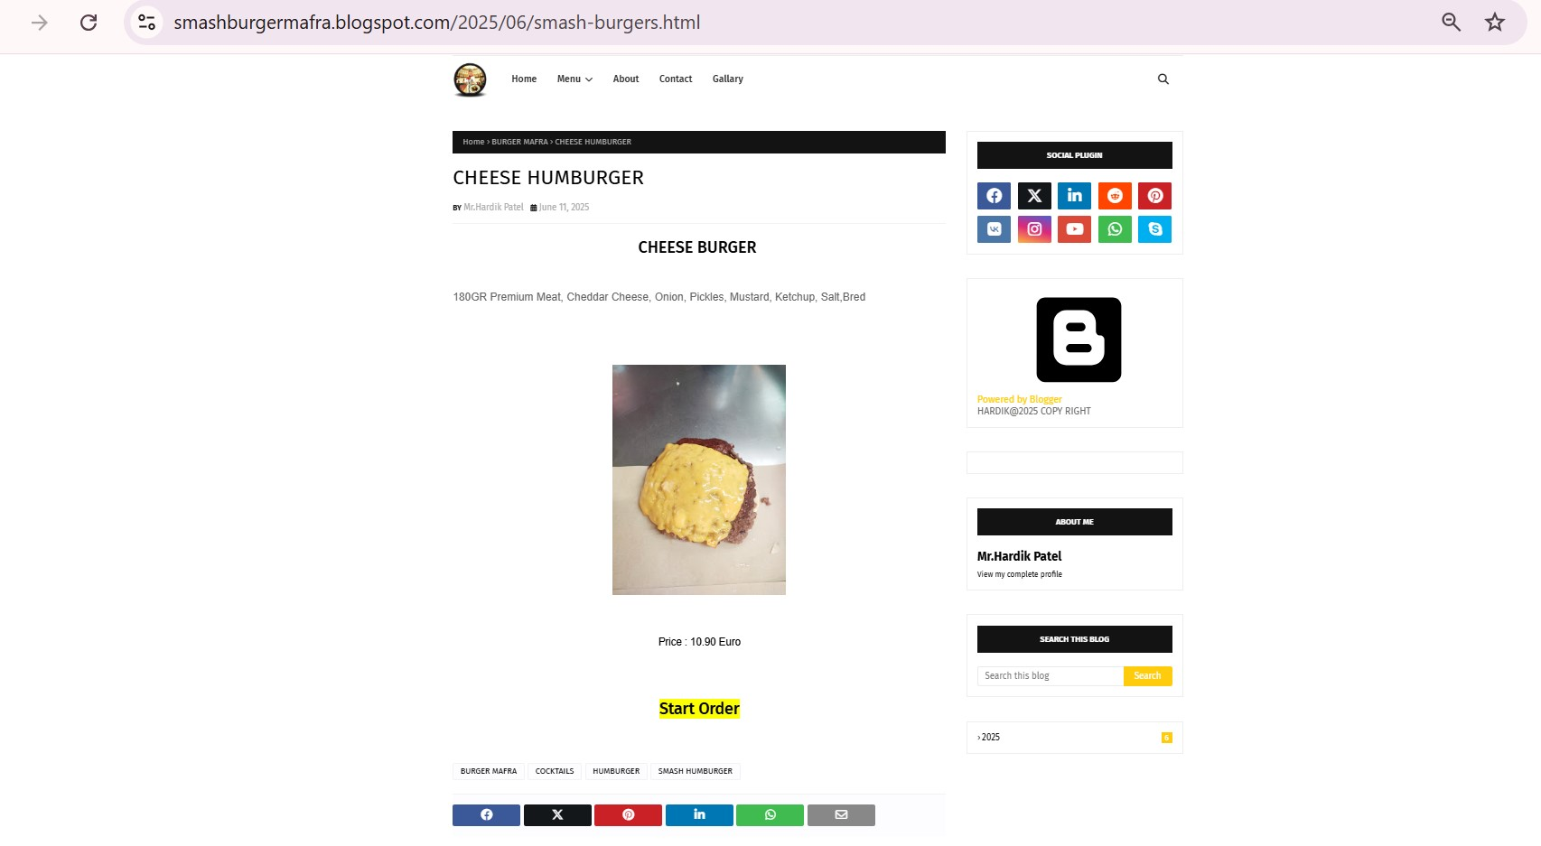
Product Page Cheese Burger

Slide 15
TASK 3 - PICKING UP THE PAGES
Now, come up with an idea for your website’s one blog page and its topics, one product page, and one product category page.

Slide 16
TASK 4 - CONTENT STRUCTURE
In the fourth step, you have to create a content structure for all three pages that are mentioned in the previous step.

Slide 17
Food
Burger
Combo
Extra
CheesBurger
BaconBurger
Combo
CheesBurger
Combo
BaconBurger

Slide 18
TASK 5 - COMPETITIVE ANALYSIS
Conduct the SEO Competitive Analysis by finding a competitor. Analyse Your Competitors' Top Pages, Keyword gaps, strengths, and weaknesses. You can do it by listing down all the top websites/webpages that appear on the search engine result page and the top-ranking keywords for the brand.

Slide 19
TASK 6 - KEYWORD RESEARCH
Next, you have to do the keyword research for each of the three pages using google and other tools available and list down all the important keywords for all the 3 pages.

Slide 20
TASK 7 - ON-PAGE ELEMENTS
You also have to list down all the On-page elements that you are going to use while optimising the website.

Slide 21
On Page Work
Meta Tag Title Discripton
Gernerate Robot.Txt
Then go To Google Console and do SiteMap
Then Make A Post And Page
Every Post Write a Meta Tag Discripton Title in html code.
Then set Label Pulished Date Location Search Discription and custom robot tag check mark all option.
Then Change Theme If You Want And Edit Layout Like Menu Social Media and Link Pages.

Slide 22
TASK 8 - EXAMPLE BLOG
Write a 300-word paragraph on the blog topic that you've picked up. Use keywords and write the on-page elements for it.
Meta Tag Title Discripton
Gernerate Robot.Txt
Then go To Google Console and do SiteMap
Then Make A Post And Page
Every Post Write a Meta Tag Discripton Title in html code.
Then set Label Pulished Date Location Search Discription and custom robot tag check mark all option.
Then Change Theme If You Want And Edit Layout Like Menu Social Media and Link Pages.

Slide 23
CONCLUSION AND TAKEAWAYS
How this project has helped you to understand the objectives and goals of the SEO Strategy
Briefly explain, how you are going to use the knowledge of SEO Strategy to achieve your goals and targets in Digital Marketing

